Slide 1


OFFICIAL & BUSINESS LETTER WRITING
CO1- Write professionally in simple and correct English.

Slide 2

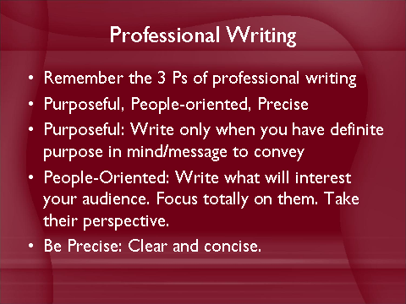
Thumb Rule

Slide 3

Definition of Letter
A written form of communication, written by an authorized person of an organization, is called a business letter.
They serve as a means to reach out to people not only within the locality and neighborhood but also in other cities and nations.

Slide 4
SIGNIFICANCE OF BUSINESS LETTERS
Assists in sustaining business relationships
Appropriate form of communication for complex information.
Serves as permanent records. Valuable repository of information for future.
Helps in reaching a large and geographically diverse audience.
Economic (as compared to phone calls)

Slide 5
Steps
Planning
of
Writing
Writing
Editing
Letter
Revising

Slide 6

Seven Cs of
an Effective Business Letter

Slide 7
7 Cs
Consideration
Courtesy
Clarity
Concreteness
Correctness
Conciseness
Completeness

Slide 8

Formats of Business Letters
Full Block Format
Modified Block Format
Semi Block Format
Simplified Block Format

Slide 9
Full Block Format
Most common format in use today,
It is the easiest to remember and it is well suited to the way a word processor works.
Every line begins at the left margin, the return address, complimentary closing, signature, and even the first line of each paragraph.
Paragraphs are separated by a double space.

Slide 10
123 Centre Street
Yorkton, NS B4T 1Y9
February 21, 2005
John Clancy
Personnel Manager
Greenbay Publishers Inc.
99 Hollingshead Road
Fredericton, NB
Dear Mr. Clancy
We are pleased to _______________________________your account.
In addition,________________________________________the work.
It would be our pleasure________________________contact us.
Yours truly
Shirley Paterson
Shirley Paterson
Director of Research
Sample

Slide 11
Modified Format Differs from full block in the positioning of certain elements like the heading, dateline, complimentary close, signature block are right aligned.

Slide 12
123 Centre Street
Yorkton, NS B4T 1Y9
February 21, 2005
John Clancy
Personnel Manager
Greenbay Publishers Inc.
99 Hollingshead Road
Fredericton, NB
Dear Mr. Clancy
We are pleased to _______________________________your account.
In addition,________________________________________the work.
It would be our pleasure________________________contact us.
Yours truly
Shirley Paterson
Shirley Paterson
Director of Research
SAMPLE

Slide 13
Semi Block Layout
Resembles modified block style except that the first line of each paragraph is indented.

Slide 14
Simplified Layout Omits salutation
Often includes a subject line in capital letters.
Omits complimentary close.
Convenient when the recipient is not known to you.
Objections are raised on impersonal approach.

Slide 15

Types of Business Letters
Acceptance Letter (yes/ legal)
Acknowledgement Letter (Receipt)
Adjustment Letter (a legal document / addresses a complaint or claim)
Application Letter (request job consideration/ interview)
Complaint Letter (a legal document)
Cover Letter (accompanies resume or order)
Inquiry Letter (posing a question)
Order Letter (request letter)
Refusal Letter (reject an offer)
Response Letter (answers inquiry)
Sales Letter (marketing)

Slide 16
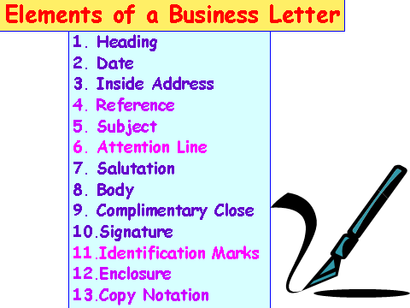

Slide 17
How To Write An Official Letter
Official letters help express an opinion or provide important information to others professionally. A well-drafted official letter can help you convey your message of acceptance, interest, complaint, gratitude or recommendation effectively. When writing an official letter, it is important to follow a specific structure or format throughout the entire document.

Slide 18
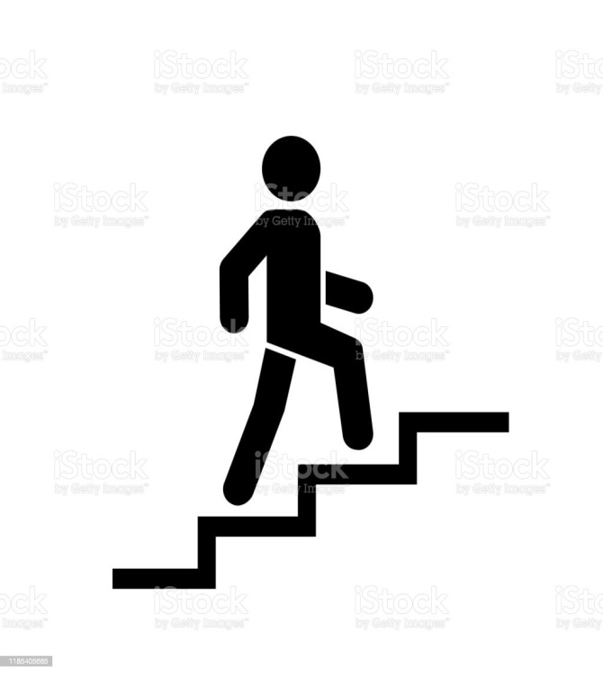
Step-by-step process to writing an official letter:
Choose a professional font and size
Pick a format and follow the template
Create your heading
Begin your introduction with a salutation
Use body paragraphs to state your reason for writing
Add your conclusion paragraph and signature
Mention and add your enclosures
Proofread your letter before sending it

Slide 19
Job Application Letters

Slide 20
Job application letters are written while applying for a job. Job application letter is written for offering one’s services to the prospective employer. Through this letter, one tries to sell his services. It is accompanied with resume or curriculum vitae including all the essential principles of formal business letter.
The purpose of job application letter is to persuade targeted employers to read the attached resume or curriculum vitae. Through this process, one motivates the employer to contact him for further interview.

Slide 21
Types of Job Application Letters
Job application letters are of following two types:
(a) Solicited Job Application Letters:
These are written in response to an announced or advertised post.
(b) Unsolicited Job Application Letter:
These are written and sent to an organization that has not announced or advertised a post.

Slide 22
Resume Making
In modern world of Science and Technology resume writing has become an art.
A ‘resume’ is an abstract (summary) or selective record of one’s achievements including education, work experience, abilities and so on.
As per Pauley and Riordan
“Your resume is a one-page (sometimes two page) document that summarizes your skills, experiences and qualifications for a position in your field”.
The words like Bio-data and Curriculum Vitae are often used for a resume.

Slide 23
Guidelines for Writing Good Resume:
i) The resume should be well written, sentences and paragraphs should be short and simple.
(ii) Use of Jargons should be avoided.
(iii) It should provide all necessary information, relating to the applicants education and experience.
(iv) Any personal information which is not directly related to the job should not be included.
(v) It should be complete in all respects.

Slide 24
RESUME TYPES:
Resume is mainly of following four types:
(i) Chronological Resume
(ii) Functional Resume
(iii) Hybrid / Combination Resume
(iv) Electronic Resume – ASCII (American Standard Code for Information Interchange / HTML (Hyper Text Markup Language) formats.

Slide 25
Chronological Resume:
In this type of resume the information is chronologically (as per time) arranged. This makes it easy to get an idea about the previous work experience of the candidate. The main sections of the chronological resume are as follows:
a) Career Objective
b) Summary (optional)
c) Educational History
d) Personal Data
e) Work History

Slide 26
Functional Resume
In functional resume, the main focus is laid on skills & experience. In this type of resume the candidate mentions his skills and work experience pertaining to the post applied for. The main sections of the functional resume are as following:
a) Career Objective
b) Personal Data
c) Educational details
d) Work Experience
e) Skills and Certifications

Slide 27
Hybrid / Combination Resume
These are combination of Chronological and Functional resumes

Slide 28
Electronic Resume
Electronic resumes are prepared for the purpose of uploading on the world wide web’s using ASCII (American Standard Code for Information Interchange) or HTML (Hyper Text Markup Language) formats, so that prospective employers can view them.

Slide 29
Differentiate between Resume, C.V. & Bio-Data
Bio-Data:
Information about a person and about what they have done in their life.
Resume: A short summary or account of something.
Curriculum Vitae: A written record of your education and the jobs you have done, that you send when you are applying for a job.

Slide 30
CURRICULUM VITAE:
C.V. is a Latin word meaning "course of life". Curriculum Vitae (C.V.) is therefore a regular or particular course of study pertaining to education and life. A C.V. is more detailed than a resume, usually 2 to 3 pages, but can run even longer as per the requirement.
A C.V. generally lists out every skills, jobs, degrees, and professional affiliations the applicant has acquired, usually in chronological order.
A C.V. displays general talent rather than specific skills for any specific positions.

Slide 31
THANK YOU

